Slide 1
Distributed Cloud Computing with StarCluster (DC2S)
CHRISTIAN ANGELES
JOHN ZAVALA

Slide 2
Project Description
Our goal is to simulate computational offloading of a compute-intensive task on an android application to a cloud server.
Server will complete the task via distributed computation.
Data will be an array of at least 1,000,000 elements conceptualizing a large data set--data that is too large to store on an android device.
Program on the cloud server will be performing an exhaustive search and comparison to simulate the computational offloading.
In order to create a compute-intensive environment, the algorithm is going to search and compare the 1,000,000-element-sized array with itself. Forcing the algorithm to perform with a time complexity of O(n^2). A slower time run will allow us to see a difference in computational performance.

Slide 3
Project Environment
Amazon Web Services(AWS) EC2
Starcluster AMIs
Android OS
Linux OS
StarCluster
Message passing interface(MPI)
mpi4py for Python

Slide 4
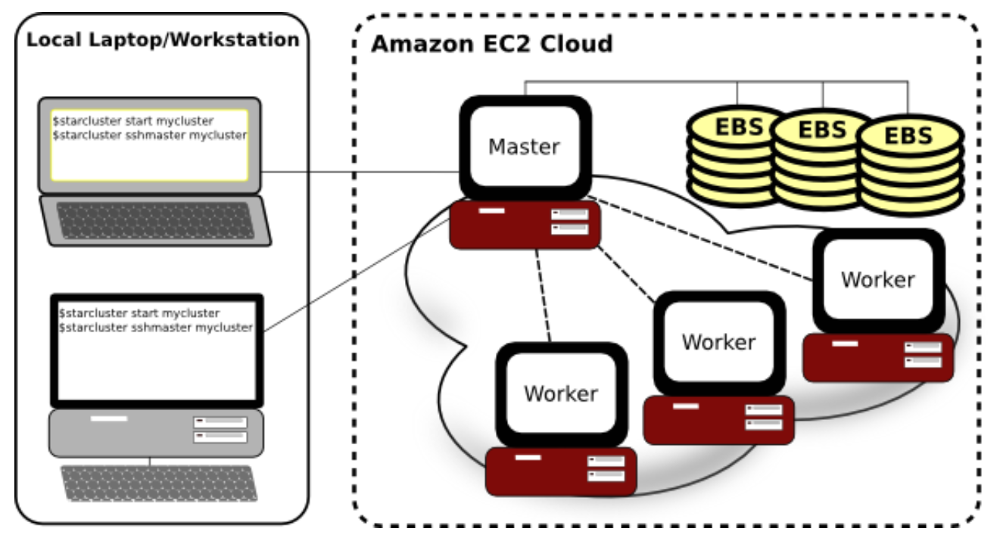
StarCluster
StarCluster- Is a tool kit that manages computer clusters hosted on Amazon’s EC2 Cloud. It is designed to automate and simplify the process of building, configuring, and managing clusters of virtual machines.
Notes:
Image from http://star.mit.edu/cluster/

Slide 5
StarCluster
Security Groups- The starcluster configures a security group for our cluster allowing us to control network access to the cluster.
Password-less SSH: The star cluster configures the cluster in order for the SSH to be used from any node within the cluster without having to login using a password.
Network File System (NFS)- able to attach Elastic Block Storage (EBS) volumes on the cluster in order to obtain persistent storage.
StarCluster can dynamically resize clusters in order to make it scalable.
Combination of OpenMPI and Sun Grid Engine (SGE)

Slide 6
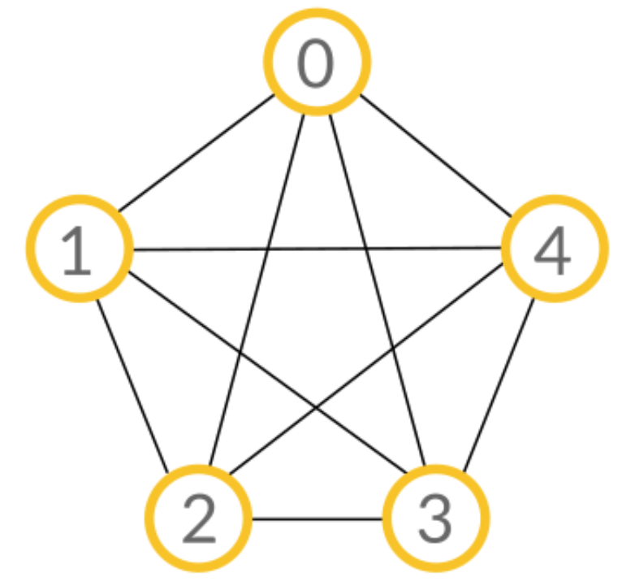
Message Passing Interface(MPI)
MPI- Standardized message passing library interface that can be used in different languages (ex. C, C++, python).
MPI is good for high performance computing and parallelism because it handles the passing of messages between different processes.
Distributed computing- Takes a single task and distributes it among computers in order to complete a task.
Point to point communications- MPI uses point to point communications to communicate from one process to another.
Blocking/Non-blocking communication
Race conditions
Notes:
Image/GIF from https://www.codingame.com/playgrounds/349

Slide 7
Message Passing Interface(MPI)
Collective communication- There are two types: Broadcasting and Scattering/Gathering.
Broadcasting: One process broadcasts the same information to every process.
Notes:
Image/GIF from https://www.codingame.com/playgrounds/349

Slide 8
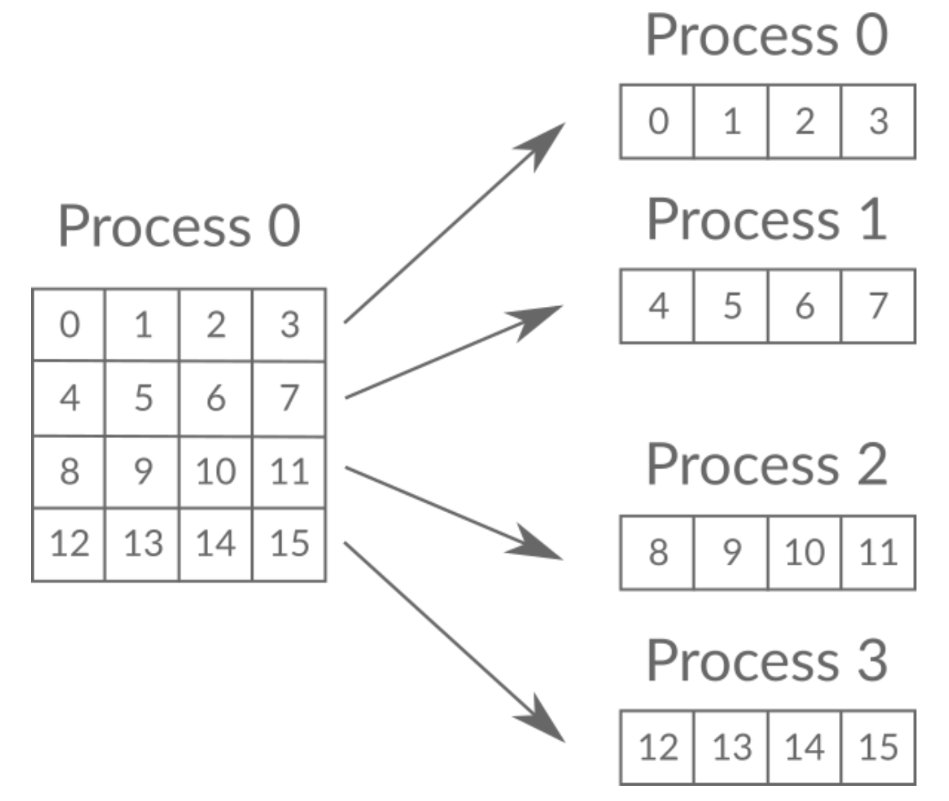
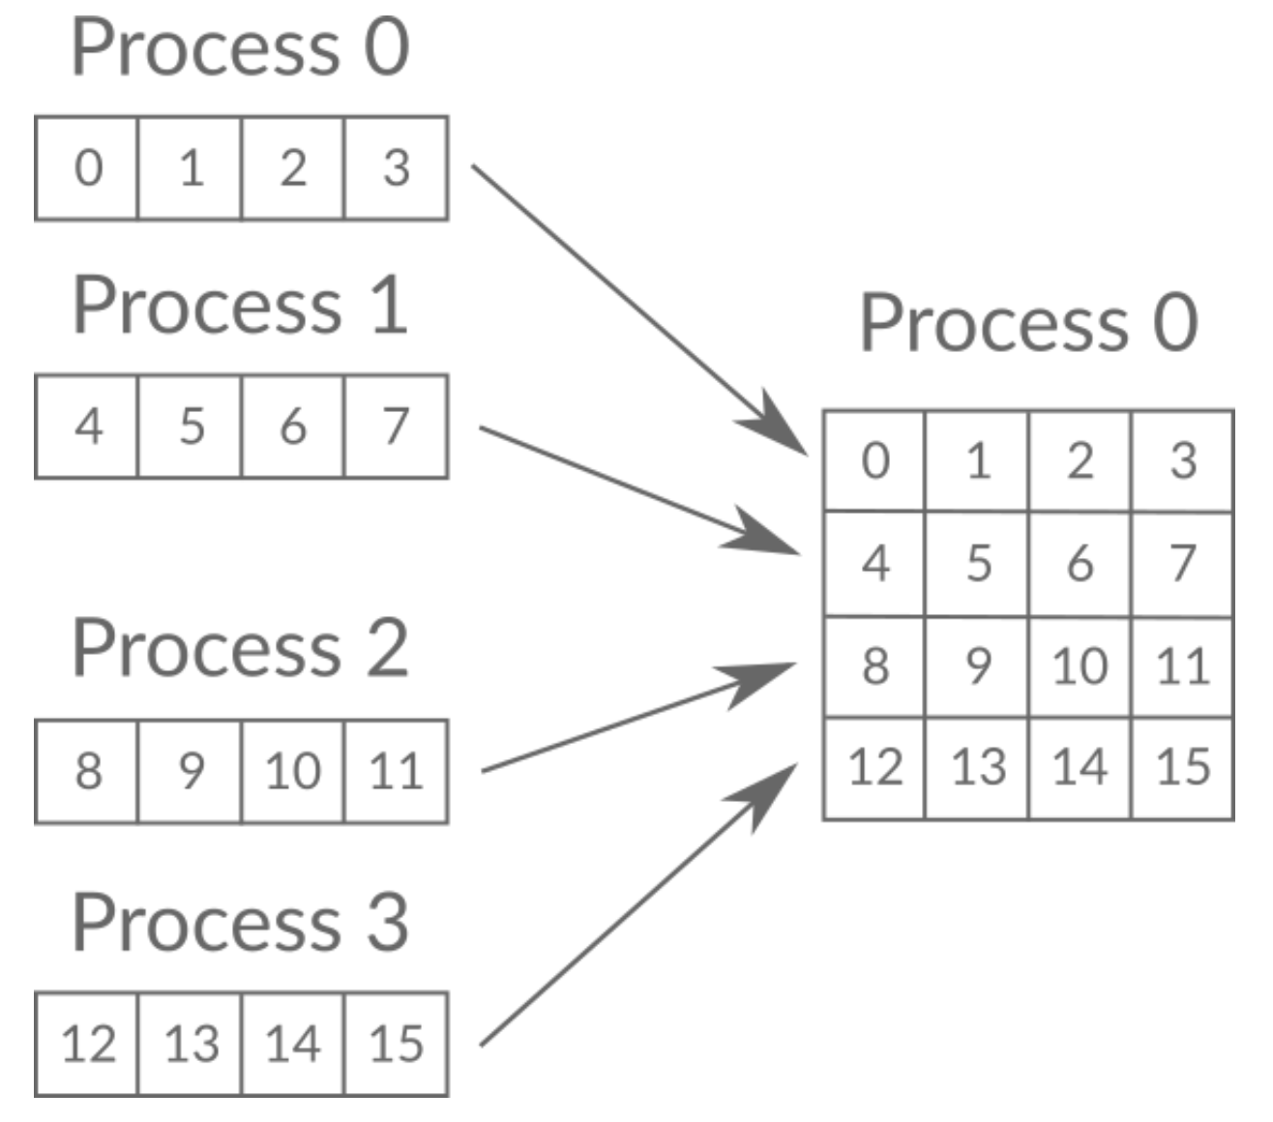
Message Passing Interface(MPI)
Collective communication- There are two types: Broadcasting and Scattering/Gathering.
Scattering/ Gathering: Are used in order to distribute and gather data.
Notes:
Image/GIF from https://www.codingame.com/playgrounds/349

Slide 9
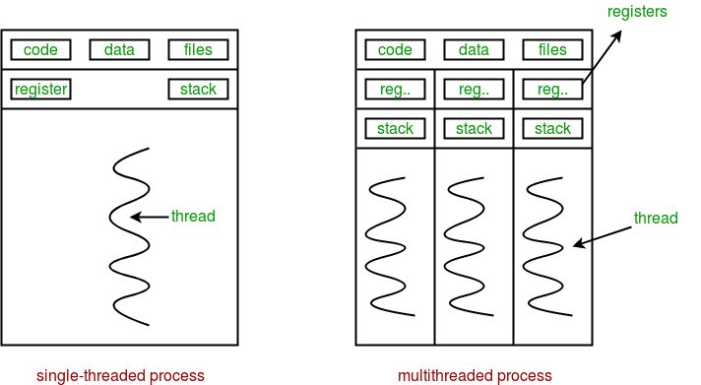
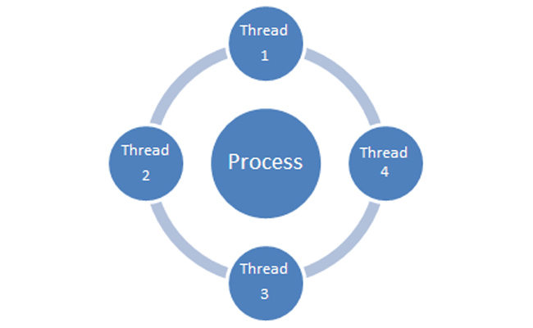
Multithreading
➤ Multithreading is an execution model that allows multiple threads to be created within a process such that the threads execute independently but share the same process resources.
➤ Every thread contains a unique register set and local variables. (Local variables are stored in the stack).
➤ All the threads within the process share the same global variables and code.( The global variables are stored in the heap).
➤Main reason we are using multithreading rather than multiprocessing is because of less overhead. It’s a more efficient way of performing the task.

Slide 10
Cloud Server
Written in python for easy implementation
MPI support with mpi4py
Socket programming
Multiprocessing/Multithreading libraries
Main process
Listens for client connection
Creates a thread for each client connection
Launches separate process for distributed computing
MPI process
Processes created for each node
Divides array into segments
Creates multiple threads for each segment

Slide 11
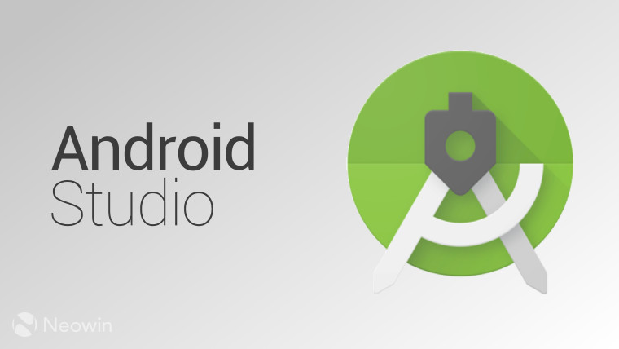
Android Application
Application development in Android Studio.
Designed a simple user interface
Single button to start
Contains implementation of socket programming in order to establish a connection to the cloud
Creates a separate thread for connection to the cloud server
AsyncTask

Slide 12
Demonstration

Slide 13

Lessons learned
AWS Elastic Cloud Computing (EC2)
Creating instances
Configuring network security group
Allows android application to connect
StarCluster
Parallel Computing
MPI(Message Passing Interface)
SGE( Sun Grid Engine)
Multiprocessing/Multithreading
Android
Python

Slide 14
References
StarCluster
http://star.mit.edu/cluster
Distributed computing with MPI
https://www.codingame.com/playgrounds/349
Open MPI
https://www.open-mpi.org
mpi4py
https://mpi4py.readthedocs.io

Slide 15
Thank you!
Questions?

